Slide 1

CSE205
Data Structures
Lecture #5
Complexity Analysis
Recursive Tree and Master Method
By: Mohammad Shabaz

Slide 2
Recursion-tree method
A recursion tree models the costs (time) of a recursive execution of an algorithm.
The recursion tree method is good for generating guesses for the substitution method.
The recursion-tree method can be unreliable, just like any method that uses ellipses (…).
The recursion-tree method promotes intuition, however.

Slide 3
Example of recursion tree
Solve T(n) = T(n/4) + T(n/2) + n²:

Slide 4
Example of recursion tree
Solve T(n) = T(n/4) + T(n/2) + n²:
T(n)

Slide 5
Example of recursion tree
Solve T(n) = T(n/4) + T(n/2) + n²:
n²
T(n/4)
T(n/2)

Slide 6
Example of recursion tree
Solve T(n) = T(n/4) + T(n/2) + n²:
n²
(n/4)²
(n/2)²
T(n/16)
T(n/8)
T(n/8)
T(n/4)

Slide 7
Example of recursion tree
Solve T(n) = T(n/4) + T(n/2) + n²:
n²
(n/4)²
(n/2)²
(n/16)²
(n/8)²
(n/8)²
(n/4)²
…
Θ(1)

Slide 8

Example of recursion tree
Solve T(n) = T(n/4) + T(n/2) + n²:
n²
(n/4)²
(n/2)²
(n/16)²
(n/8)²
(n/8)²
(n/4)²
…
Θ(1)

Slide 9
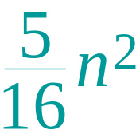
Example of recursion tree
Solve T(n) = T(n/4) + T(n/2) + n²:
n²
(n/4)²
(n/2)²
(n/16)²
(n/8)²
(n/8)²
(n/4)²
…
Θ(1)

Slide 10
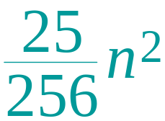
Example of recursion tree
Solve T(n) = T(n/4) + T(n/2) + n²:
n²
(n/4)²
(n/2)²
(n/16)²
(n/8)²
(n/8)²
(n/4)²
…
…
Θ(1)

Slide 11
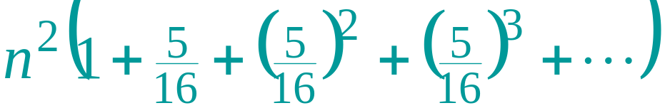
Example of recursion tree
Solve T(n) = T(n/4) + T(n/2) + n²:
n²
(n/4)²
(n/2)²
(n/16)²
(n/8)²
(n/8)²
(n/4)²
…
…
Θ(1)
Total =
= Θ(n²)
geometric series

Slide 12
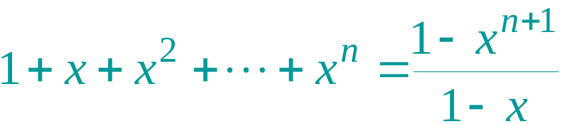
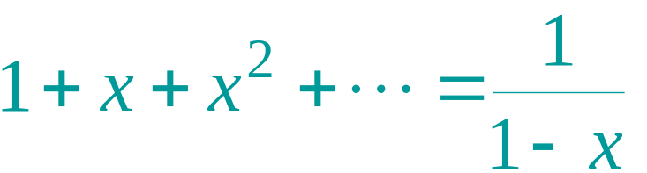
Appendix: geometric series
for x ≠ 1
for |x| < 1
Return to last slide viewed.

Slide 13
The master method
The master method applies to recurrences of the form
T(n) = a T(n/b) + f (n) ,
where a ≥ 1, b > 1, and f is asymptotically positive.

Slide 14
Idea of master theorem
Recursion tree:
f (n)
f (n)
a
f (n/b)
f (n/b)
…
f (n/b)
a f (n/b)
a
h = log_{b}n
f (n/b²)
f (n/b²)
…
f (n/b²)
a² f (n/b²)
…
…
#leaves = a^{h}
= a^{logbn}
= n^{logba}
n^{logba}Τ (1)
Τ (1)

Slide 15
Three common cases
Compare f (n) with n^{logba}:
f (n) = O(n^{logba – ε}) for some constant ε > 0.
  f (n) grows polynomially slower than n^{logba} (by an n^{ε} factor).
Solution: T(n) = Θ(n^{logba}) .

Slide 16
Three common cases
Compare f (n) with n^{logba}:
f (n) = Θ(n^{logba} lg^{k}n) for some constant k ≥ 0.
  f (n) and n^{logba} grow at similar rates.
  Solution: T(n) = Θ(n^{logba} lg^{k+1}n) .

Slide 17
Three common cases (cont.)
Compare f (n) with n^{logba}:
f (n) = Ω(n^{logba + ε}) for some constant ε > 0.
  f (n) grows polynomially faster than n^{logba} (by an n^{ε} factor),
and f (n) satisfies the regularity condition that a f (n/b) ≤ c f (n) for some constant c < 1.
Solution: T(n) = Θ( f (n) ) .

Slide 18
Examples
Ex. T(n) = 4T(n/2) + n
a = 4, b = 2 ⇒ n^{logba} = n²; f (n) = n.
CASE 1: f (n) = O(n^{2 – ε}) for ε = 1.
∴ T(n) = Θ(n²).
Ex. T(n) = 4T(n/2) + n²
a = 4, b = 2 ⇒ n^{logba} = n²; f (n) = n².
CASE 2: f (n) = Θ(n²lg⁰n), that is, k = 0.
∴ T(n) = Θ(n²lg n).

Slide 19
Examples
Ex. T(n) = 4T(n/2) + n³
a = 4, b = 2 ⇒ n^{logba} = n²; f (n) = n³.
CASE 3: f (n) = Ω(n^{2 + ε}) for ε = 1
and 4(cn/2)³ ≤ cn³ (reg. cond.) for c = 1/2.
∴ T(n) = Θ(n³).
Ex. T(n) = 4T(n/2) + n²/lg n
a = 4, b = 2 ⇒ n^{logba} = n²; f (n) = n²/lg n.
Master method does not apply. In particular, for every constant ε > 0, we have n^{ε} = ω(lg n).

Slide 20
Rough

